Slide 2
Words in our computer language
Pick cup up
Put cup down
Move cup ½ cup length right
Move cup ½ cup length left
Flip cup over

Slide 3
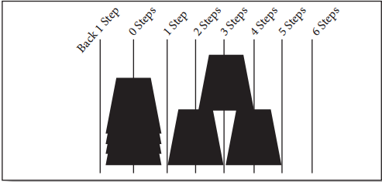

Slide 7
Words in our computer language
Pick cup up
Put cup down
Move cup ½ cup length right
Move cup ½ cup length left
Flip cup over

Slide 8
Words in our computer language
Pick cup up
Put cup down
Move cup ½ cup length right
Move cup ½ cup length left
Flip cup over

